Slide 1



E-Waste Image Classification Using EfficientNetV2B0
AICTE Student ID: STU657d23ff94d1b1702700031
AICTE Internship ID: INTERNSHIP_1746416864681834e0e35d8

Slide 2

Learning Objectives
Learn about the harmful effects of e-waste on the environment.
Use pre-trained EfficientNetV2B0 for classifying e-waste images.
Prepare and improve image data for better model training.
Build and train deep learning models using TensorFlow/Keras.
Test model accuracy and create a simple app to classify
e-waste.
Evaluate model performance using accuracy, precision, recall, and confusion matrix.
Develop a user-friendly interface with Gradio or Streamlit .
Work with real-world datasets for practical machine learning application.
GOAL

Slide 3

Tools and Technology used
Python, Jupyter Labs
TensorFlow/Keras
EfficientNetV2B0 (pretrained model)
Matplotlib, NumPy, Pandas for data handling and visualization
Gradio or Streamlit for building a user-friendly classification interface

Slide 4
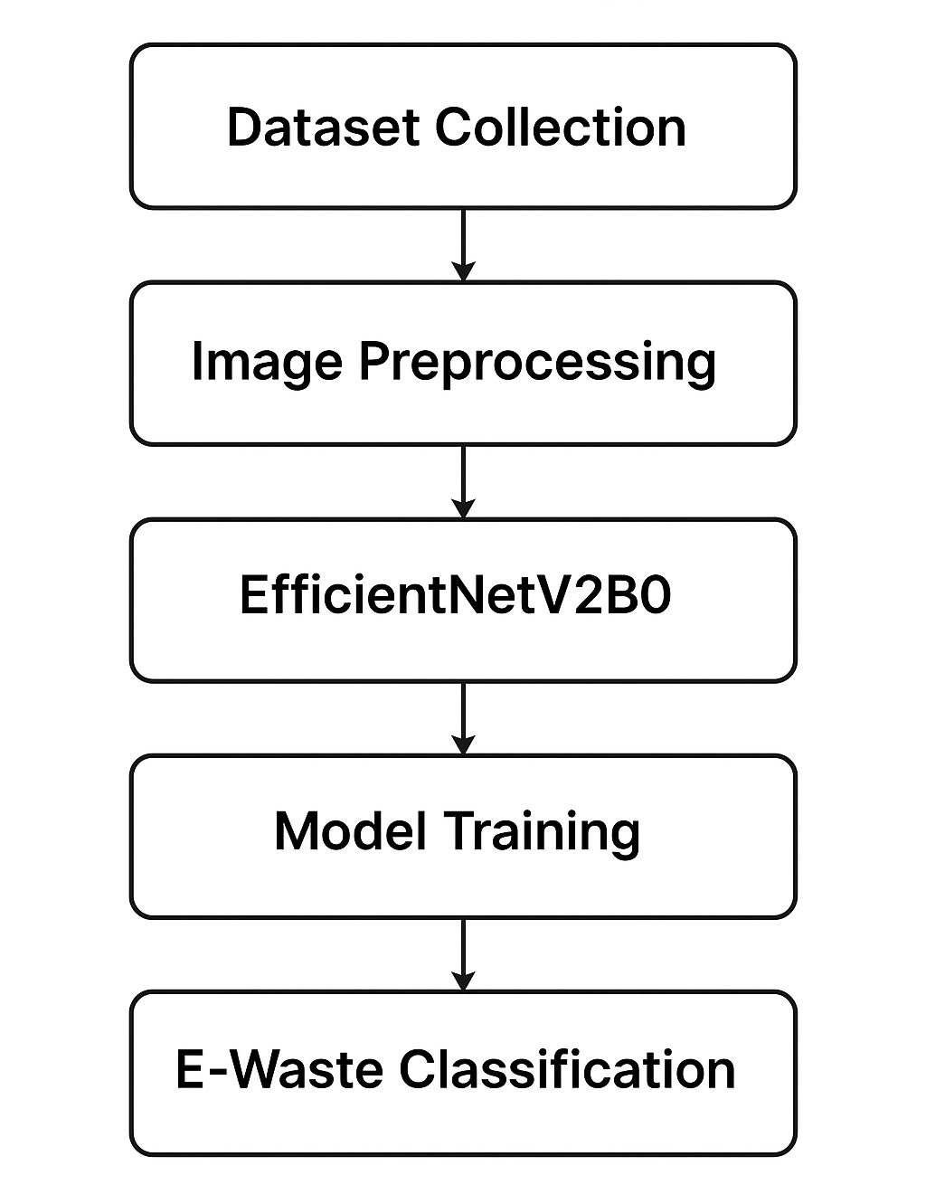
Methodology
Dataset Collection – Gather labeled images of various e-waste categories for model training.
Image Preprocessing – Resize, normalize, and augment images to prepare them for training.
EfficientNetV2B0 – Use a pre-trained EfficientNetV2B0 model.
Model Training – Train the model using the processed dataset to learn e-waste classification.
E-Waste Classification – Predict and categorize input images into one of the e-waste classes.

Slide 5
Problem Statement:
E-waste (electronic waste) is rapidly becoming a serious environmental and health issue around the world. Proper sorting and categorization of e-waste is essential for efficient recycling and disposal, but manual classification is error-prone and labor-intensive.
This project aims to build an automated e-waste classification system using artificial intelligence and machine learning. By training a deep learning model on images of different types of e-waste, we can identify and categorize them accurately.

Slide 6
Solution:
Use EfficientNetV2B0, a state-of-the-art convolutional neural network optimized for speed and accuracy.
Fine-tune the model using the labelled e-waste dataset.
Implement preprocessing (resizing, normalization, augmentation).
Evaluate the model using metrics like accuracy, precision, recall, and confusion matrix.
Use image classification with EfficientNetV2B0 to classify e-waste into 10 distinct categories to support better sorting and recycling automation.

Slide 7
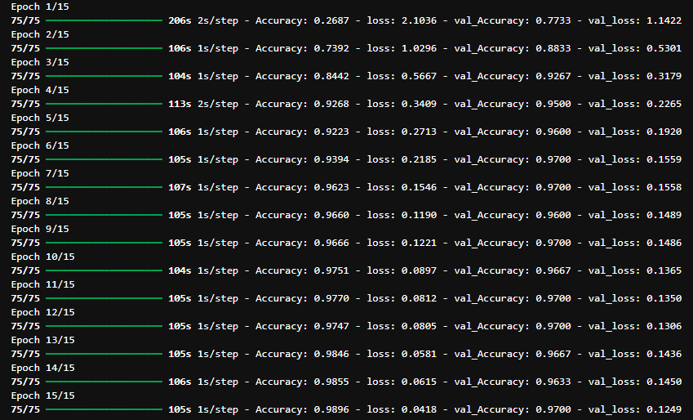
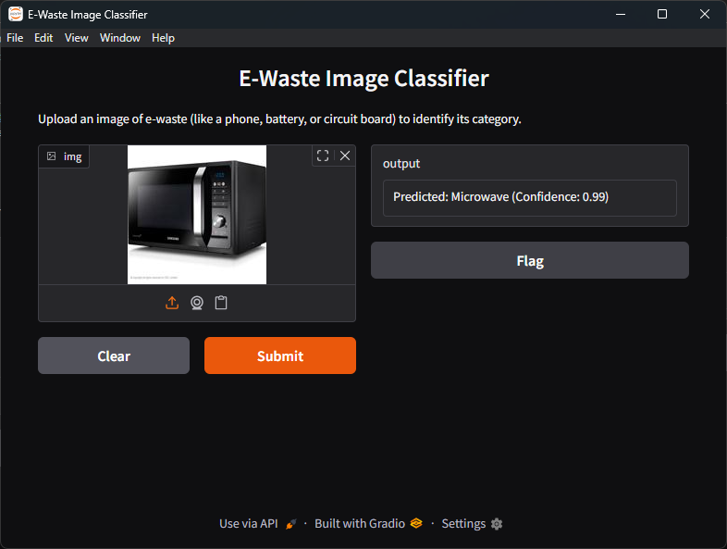
Improvements:
Done adding more Epochs and evaluating the data.
Trained the model efficiently and effectively with the given dataset.
Added Simple Title and description for the Gradio interface.

Slide 8
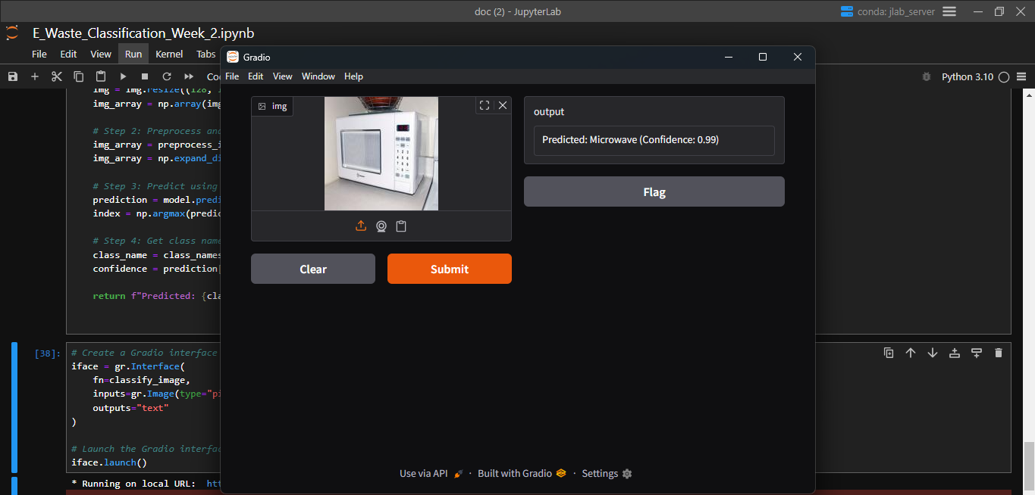
Screenshot of Output:

Slide 9
Conclusion:
An image classification model capable of identifying and labeling images of e-waste into their respective categories with high accuracy, enabling:
Faster and more accurate sorting in recycling plants.
Reduction in manual errors.
Improved environmental and economic outcomes

